Slide 1
The 7 Pillars of DEVELOPMENT
& Circular Economy
by Amédée Santalo
Notes:
To use this title animation slide with a new image simply 1) move the top semi-transparent shape to the side, 2) delete placeholder image, 3) click on the picture icon to add a new picture, 4) Move semi-transparent shape back to original position, 5) Update text on slide.

Slide 2
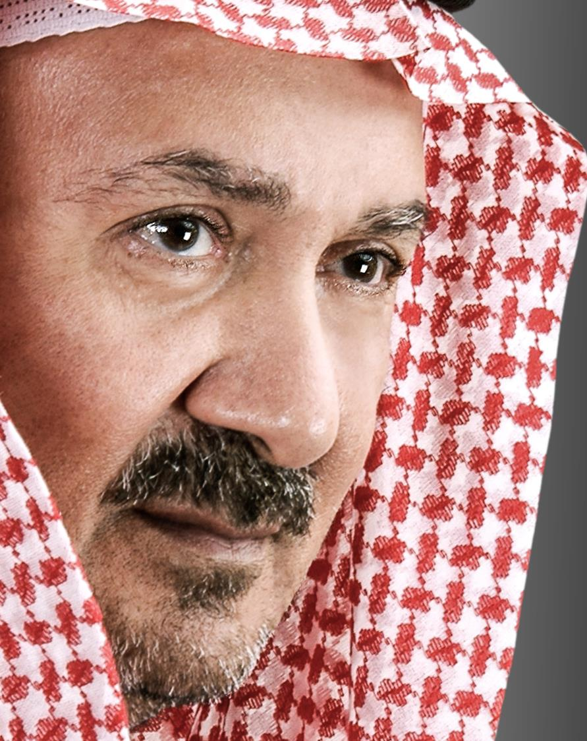
I dedicate this document to H.E. Sheikh Tarek M. Binladen.
Sheikh Tarek is truly a visionary in development and a pioneer in Smart Cities concept and design. He created Al Noor City more than 20 years ago which was the inspiration behind most of the actual Smart Cities development worldwide.
Sheikh Tarek is from a great Family who has contributed a great deal in the developments in Saudi Arabia, and various places including Dubai.
I have had the opportunity to work for His Excellency for the last 17 years.
Following his recommendations and guidance, I devote my time everyday to figure out how we can bring simple and efficient solutions for a better and a more sustainable society.
Amédée Santalo
Adviser to H.E. Sheikh Tarek M. Binladen

Slide 3
The 7 Pillars of DEVELOPMENT
1 - Food Security
2 - Infrastructure & Affordable housing
3 – Industries & Free Trade Zones
4 - Healthcare
5 - Education
6 - Energy
7 - Economy booster
Managed & Optimized by New Technologies

Slide 4
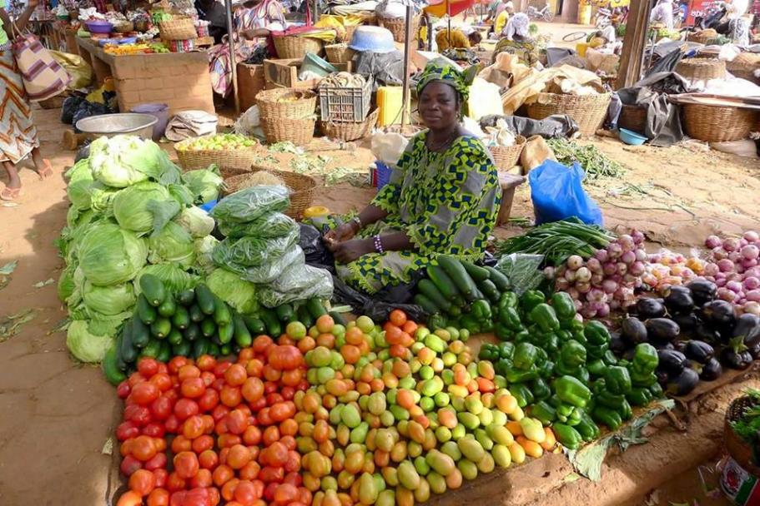
1 - Food Security
Reducing importation and transportation
Growing food directly inside and close to the cities is solving a lot of problems :
:: proximity
:: reduces pollution
:: reduces transportation / cost
:: reduces traffic in the city (delivery)
:: increases the quality of food (organic & fresh)
:: Independence & better stocks management
:: Adds more green areas in the cities
Localizing the food production
Less pollution, less traffic and better food quality will positively impact the cost of Healthcare.

Slide 5
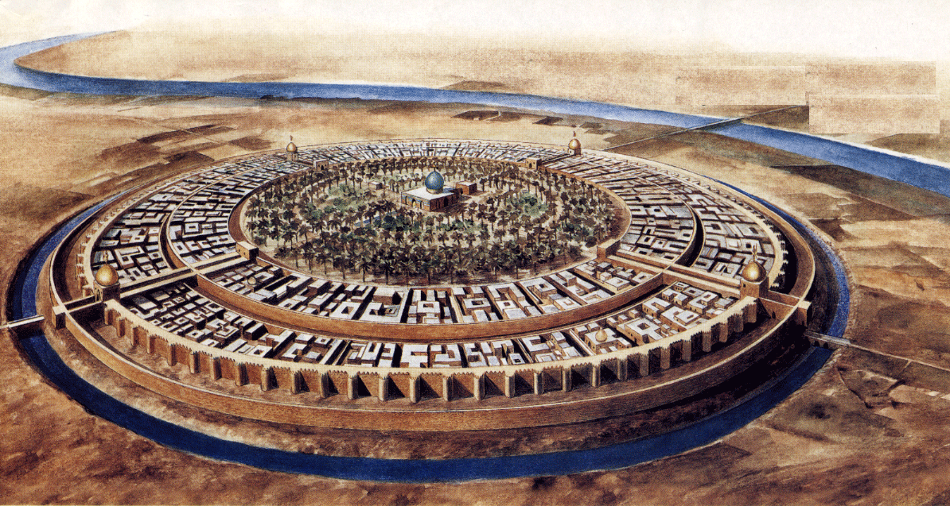
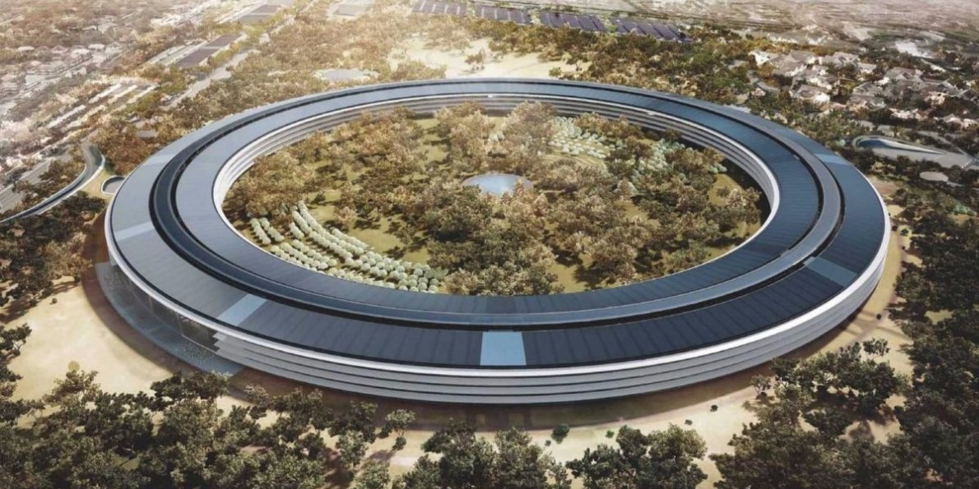
1 - Food Security
The ancient prosperous cities grew their food at the center of the city.
Localizing the food production
BAGDAD CITY – An example of prosperity
APPLE PARK symbolically based on the same model
8th century as the capital of the Abbasid Caliphate, by its caliph al-Mansur (started in 762)
Steve Jobs presents Apple City in Cupertino

Slide 6
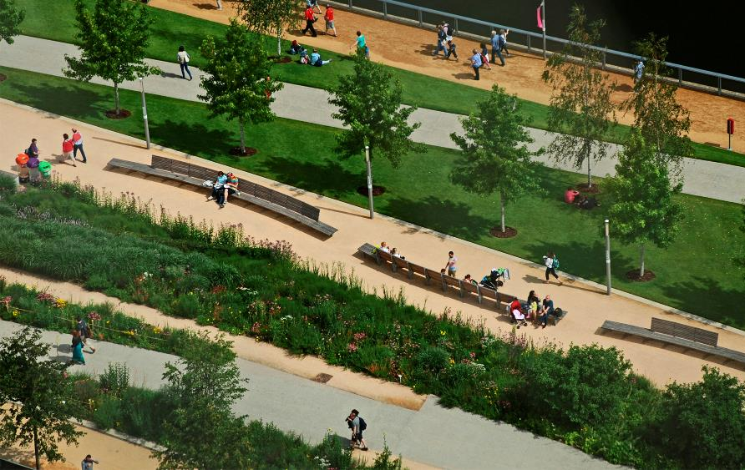
2 - Infrastructure
Quality of life for all !
Infrastructure & Affordable Housing
:: Homes for all, a roof for everyone
:: Infrastructure designed to serve and protect the population
:: Infrastructure without negative side effects on Nature
:: Protecting people
:: Connecting people (socializing & communication)
:: Connecting places of interest in order to create a dynamic economy

Slide 7
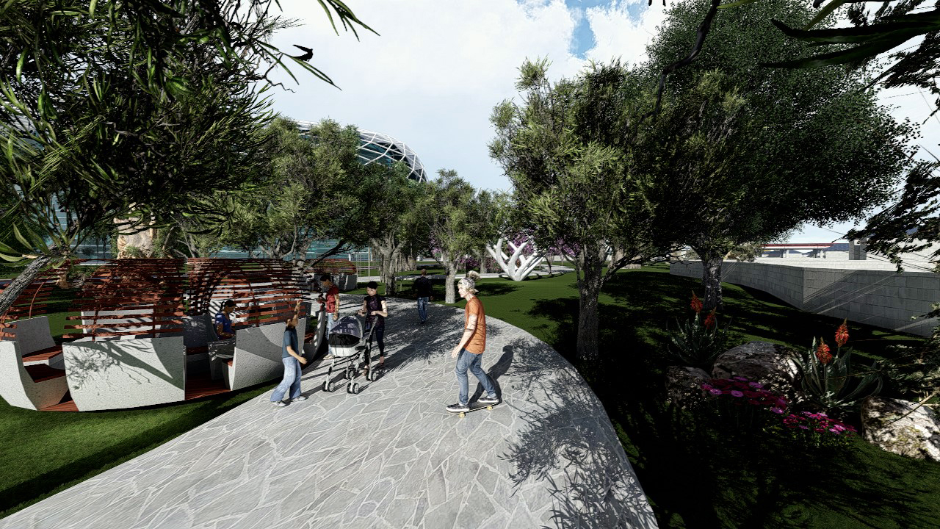
2 - Infrastructure
Connecting !

Slide 8
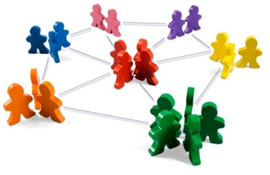
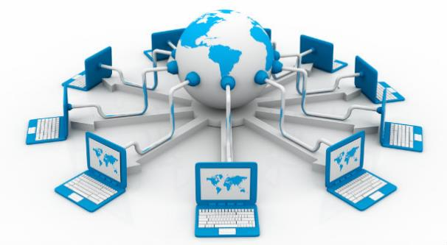
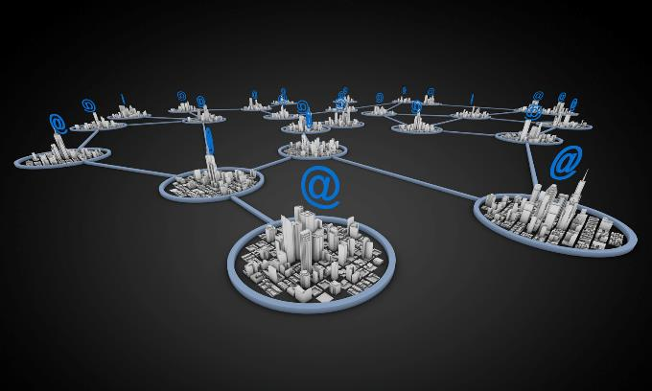
2 - Infrastructure
1- Connecting people
2 - Li-Fi connection system
3 - Solar Road System : producing electricity
4 – Connecting cities or industrial zones / hubs through fast transportation system such as Hyperloop

Slide 9
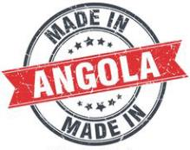
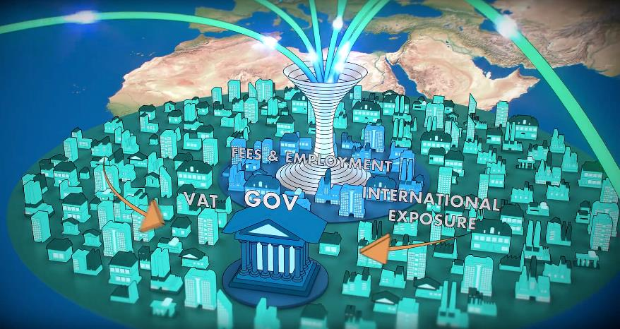
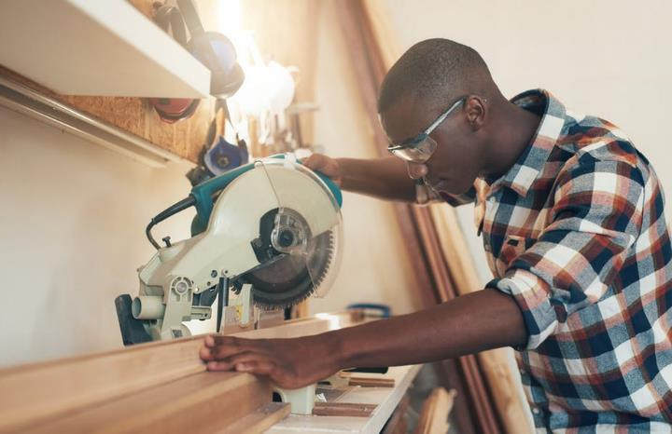
3 - Industries
And Free Trade Zones
International Free Zones
Local Craft
+

Slide 10
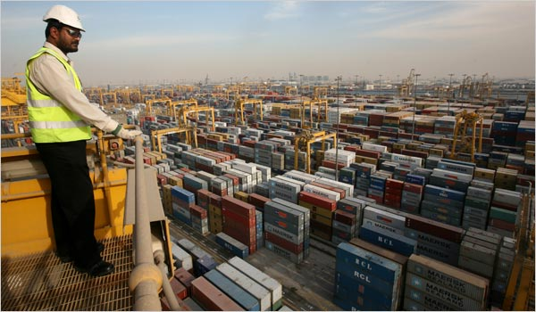
3 - Industries
Free Trade Zone … a very attractive point for locals and foreign investors !
International FTZco
:: Deferral, reduction, or elimination of certain duties.
:: Relief from inverted tariffs.
:: Duty exemption on re-exports.
:: Duty elimination on waste, scrap, and yield loss.
:: Weekly entry savings.
:: Improved compliance, inventory tracking, and quality control.
:: Waived customs duties on zone-to-zone transfers.
:: Securing ownership
:: Securing financial transactions
:: Bringing huge incomes to the local market
:: Putting the country on the trade’s world map

Slide 11
3 - Industries
Local Made !
Consumers care more than ever about where their products come from. In fact, in recent research, we found that country of origin is a more important driver of choice than price or availability and is second only to safety. In other words, people like brands from specific places and prefer them to brands that do not have a provenance story.
The “Made In” logo is a powerful tool to reinforce the image of the country locally as on international level. Competence and productivity always secure investors.
Investing in “Local Made” is investing in FUTURE !

Slide 12
4 - Healthcare
Which country can afford to not deliver a proper Healthcare program to its people ?
Healthcare for ALL !
:: Healthcare for all, from a labor to the top man of the country
:: Having a proper cardiac center in order to fight unnecessary death
:: Having an efficient emergency call center (911)
:: Medical insurance for all
:: First class medical Universities
:: First class medical equipment
:: R&D centers in medical and medications

Slide 13
5 - Education
Our Education today is old and no longer attractive and efficient.
A challenge for tomorrow’s leadership !
Education for ALL !
Countries like Finland, South Korea and a few more realized how stressful is our education system in developed countries. Education needs to adapt to the new generation (GEN-Y) due to the Digital Revolution in order to give the right tools to the youth to have great future in our society.
For the first time in the history of our world, 50% of the world’s population is formatted the same way, using the same sources of information – screen / social media / search engines like Google / same information concerning world events etc.
Youth is an important factor in development.

Slide 14
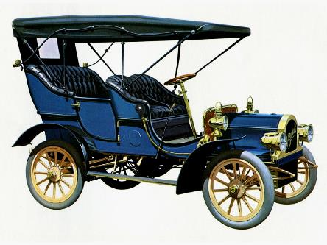
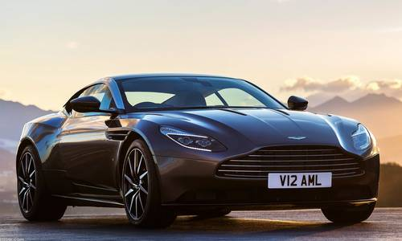
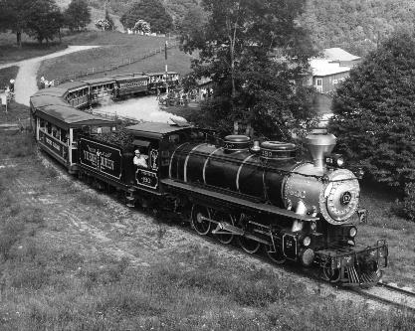
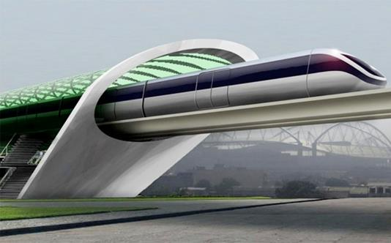
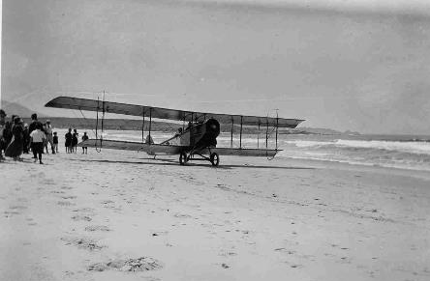
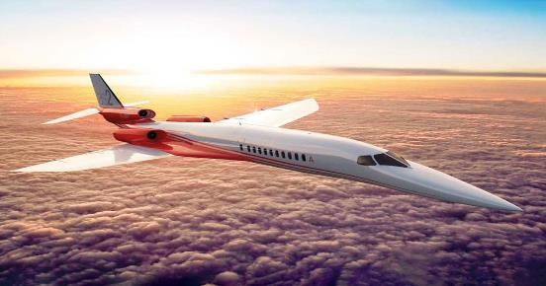
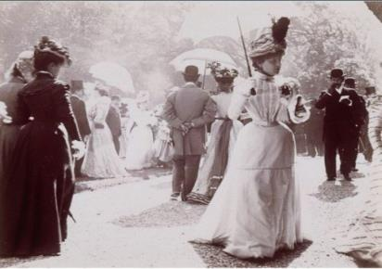
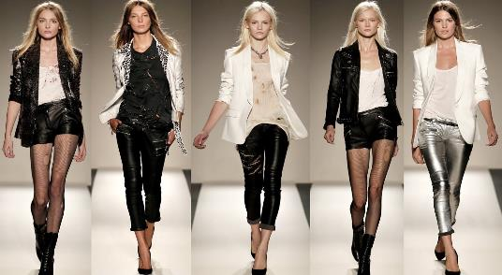
5 - Education
Everything dramatically changed during the last 100 years except our Education system.
Education for ALL !
Cars in 1900
Cars in 2000
Trains in 1900
Trains in 2000 (Hyperloop)
Planes in 1900
Planes in 2000
Fashion in 1900
Fashion in 2000

Slide 15
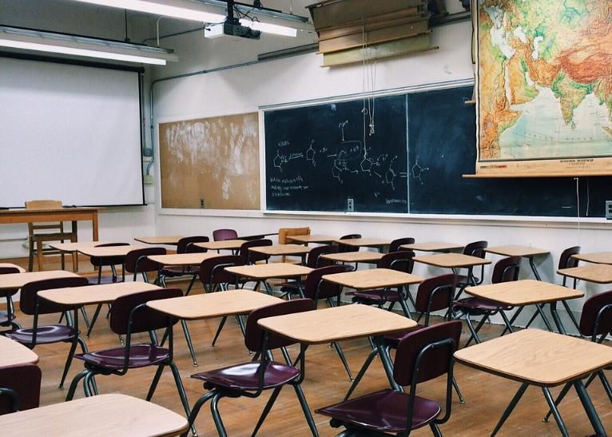
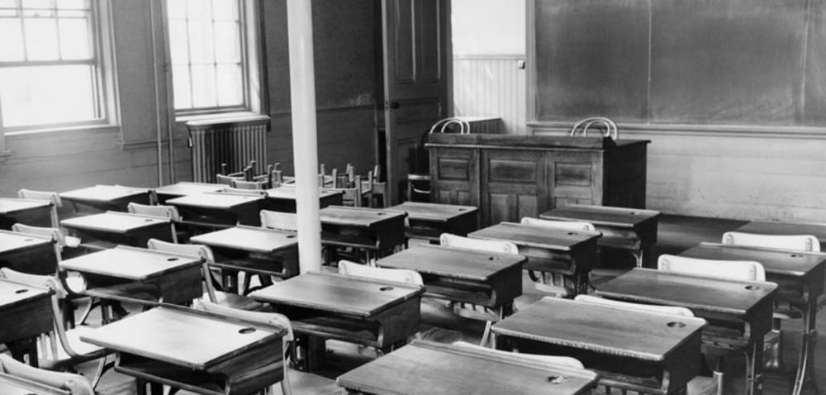
5 - Education
Everything dramatically changed in last 100 years except our Education system.
Education for ALL !
Classroom in 2000
Classroom in 1900

Slide 16
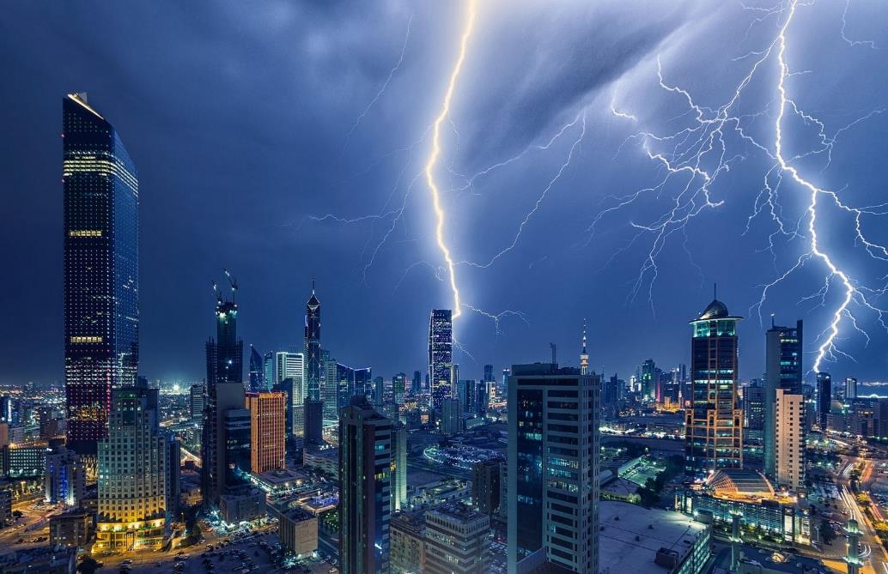
6 – Energy
Nature produces its own energy without burning or consuming anything.
Energy for all !
:: Reducing the actual consumption by 70% minimum is achievable through new products generations, changing habits (campaign of information) and better management through new technologies (Smart Management)
:: Using Biomimicry to find new sources of energy
:: Research & development center in Blue Energy (in opposition to Green energy) in order to find the best economical solutions without side effects on the planet
:: Delivering Energy to all by increasing the existing network.

Slide 17
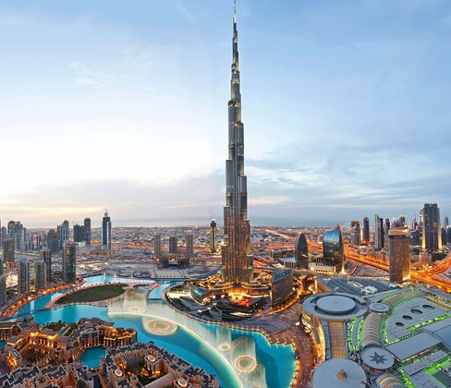
7 – Economy Booster
Each part of a city can become a fantastic motor to boost the economy
Energy for all !
:: Planning the economical development through a long term vision
:: Creating programs that will please human kind by offering what he is expected in terms of security, food and energy
:: Putting the Human at the center of the development, increasing the feeling to be part of the community (social network)
:: Creating special economic zones in order to be attractive for investors and entrepreneurs
:: Creating Iconic projects in order to attract in no time the eyes of the world on the country

Slide 18
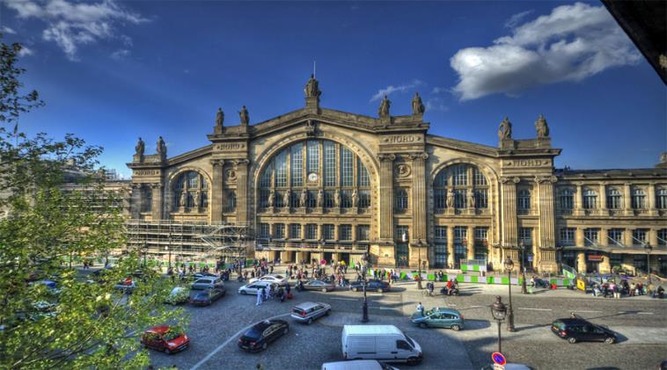
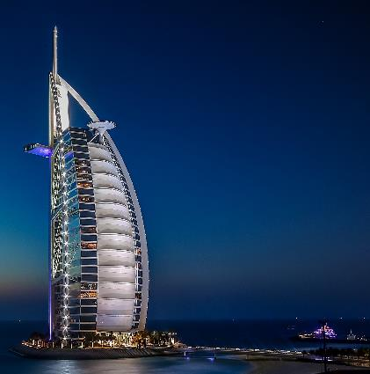
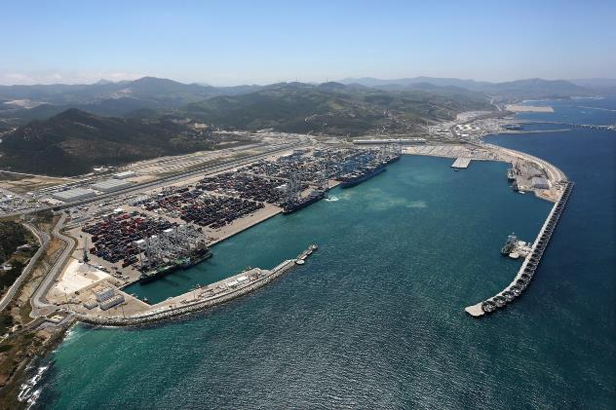
7 – Economy Booster
Energy for all !
Different types of projects considered as real Motor to boost the economy
Paris train station (Nord)
Burj Al Arab Dubai
Tangier MED Free Zone Morocco

Slide 19
The 7 Pillars of Circular Economy
Notes:
To use this title animation slide with a new image simply 1) move the top semi-transparent shape to the side, 2) delete placeholder image, 3) click on the picture icon to add a new picture, 4) Move semi-transparent shape back to original position, 5) Update text on slide.

Slide 20
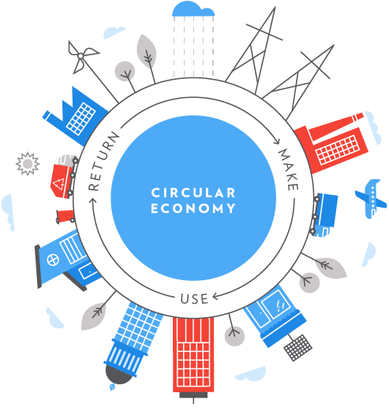
The 7 Pillars of Circular Economy
1 – Material are cycled on renewable sources
2 – All Energy is based on renewable sources
3 – Biodiversity is supported and enhanced through all Human activities
4 – Society and culture are preserved
5 – The health and wellbeing of Humans and other species are supported
6 – Human activities generate value in measures beyond just financial
7 – The economic system is inherently adaptable and resilient
Managed & Optimized by New Technologies
Source : www.greenbiz.com

Slide 21
In Conclusion
Let’s go Next step !
Development is about a certain size and a long term vision
A developer has a long term vision, designing the proper projects with the right timeline and program to insure the success of each steps.
Only a visionary person with a great experience can be the conductor of a prosperous sustainable economy.
Smart development is about Human beings, its basic needs and priorities. Technologies are here to increase its efficiency through a Smart management.
Putting back Humans at the center of the development will guaranty the most pleasant, comfortable, safe and healthy place to live in.
Nature does not produce waste, does not have unemployment, does not create pollution and does not harm the planet to create its energy … Nature is our source of inspiration !

Slide 22
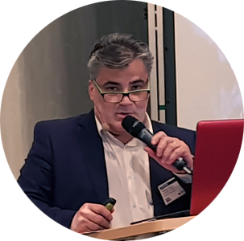
Amédée Santalo
Adviser to H.E. Sheikh Tarek M. Binladen
Concept Designer
MED LLC – Dubai – United Arab Emirates
www.alnoortower.com
+33 6 84 89 63 96
asantalo@gmail.com
www.amedeesantalo.net
www.claviscircle.com
THANK YOU

